Slide 1
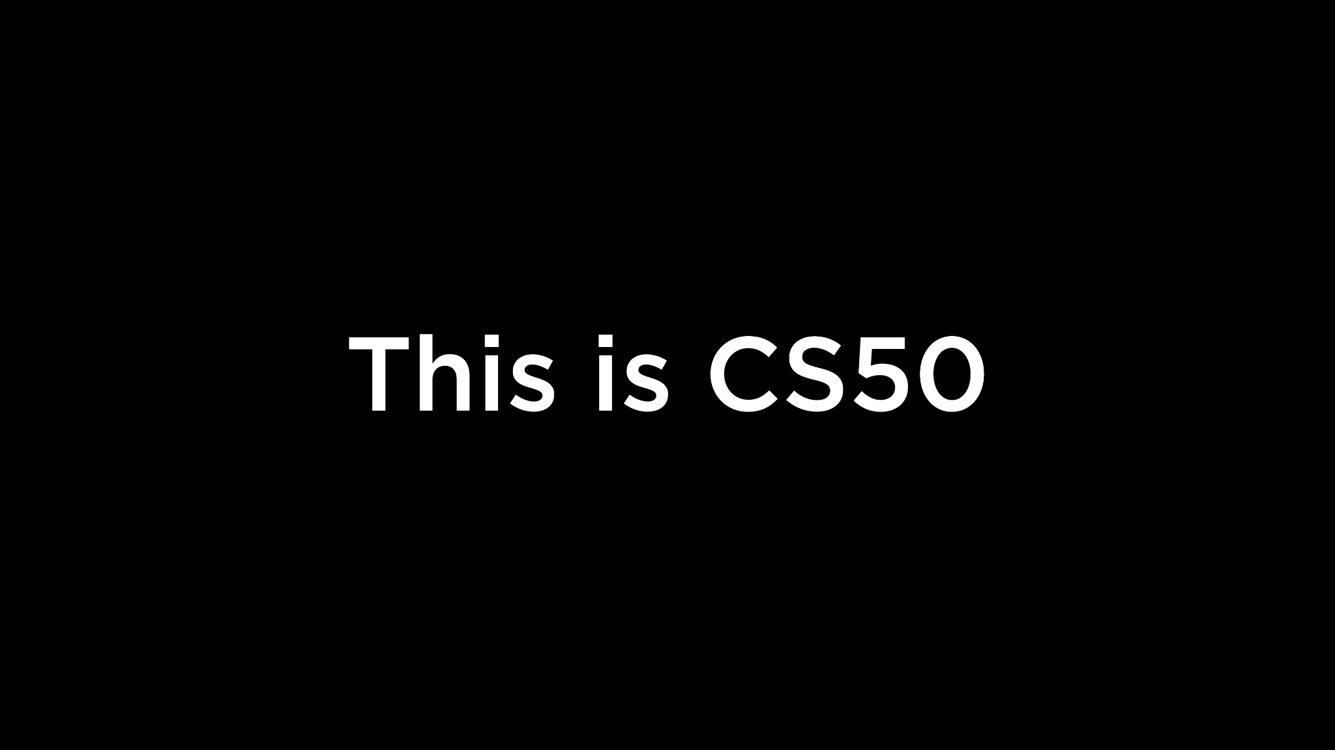
Notes:
Reload codespace
Uncheck VS Code tabs
https://www.youtube.com/watch?v=H0NflGpWgKA
https://www.youtube.com/watch?v=17MctJPzR8w

Slide 2
This is CS50
If you didn't get a rubber duck 🦆 yet, ask Yuliia during break or after class!
If you'd like to attend CS50 Lunch this Fri 10/4 at 1:15pm, RSVP at cs50.ly/lunch!
We'll be joined by alumni from Meta.
Today's snack, mini blueberry muffins! 🫐
Do say hi or ask questions during break or after class!
What do today's binary bulbs spell?

Slide 4
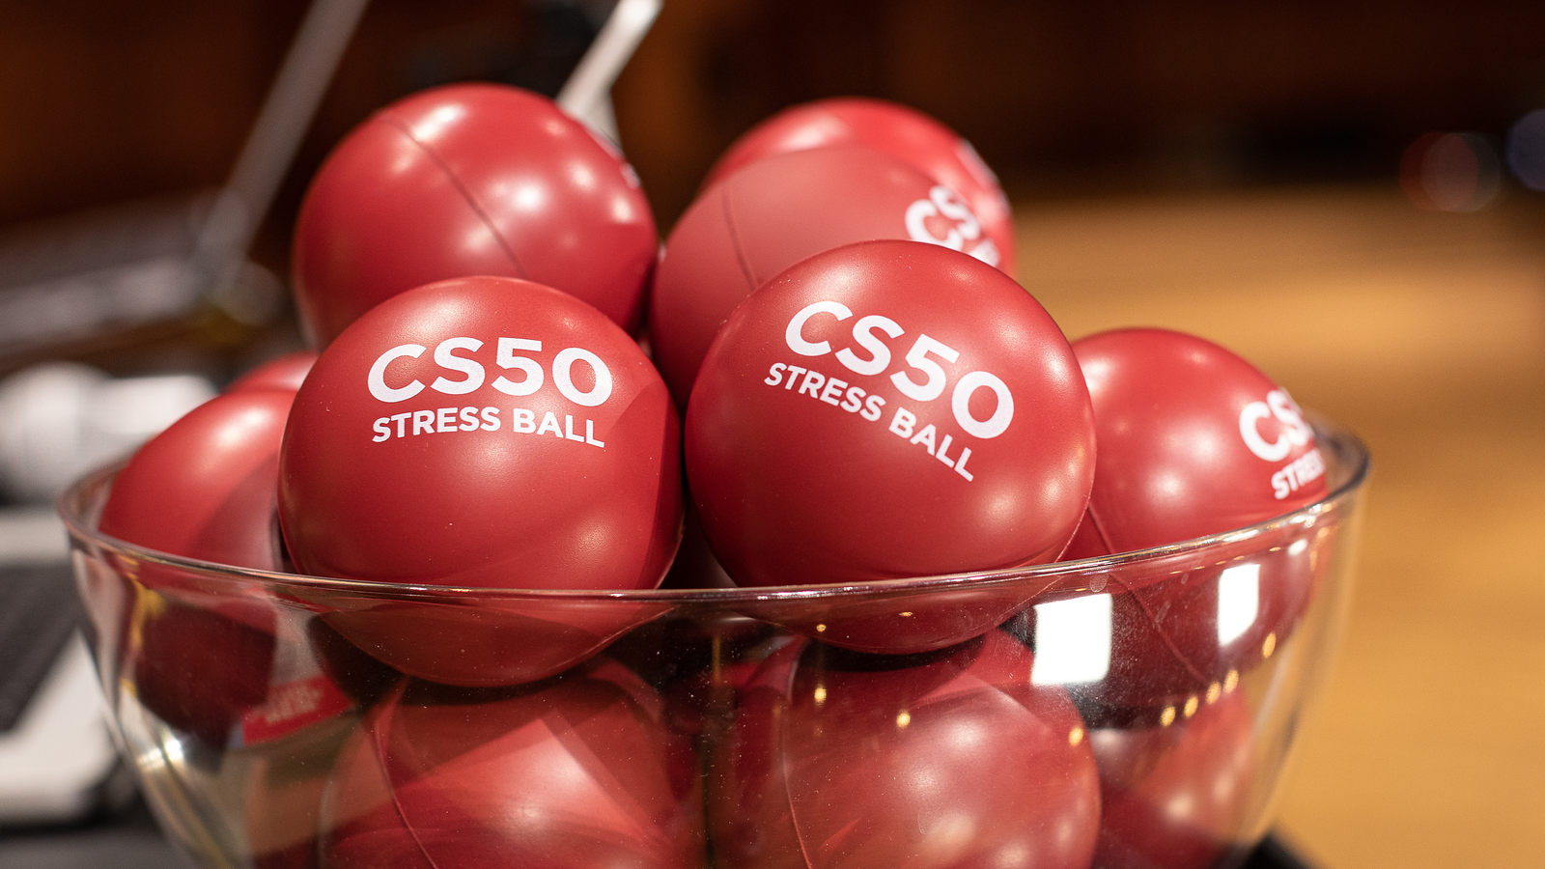

Slide 5
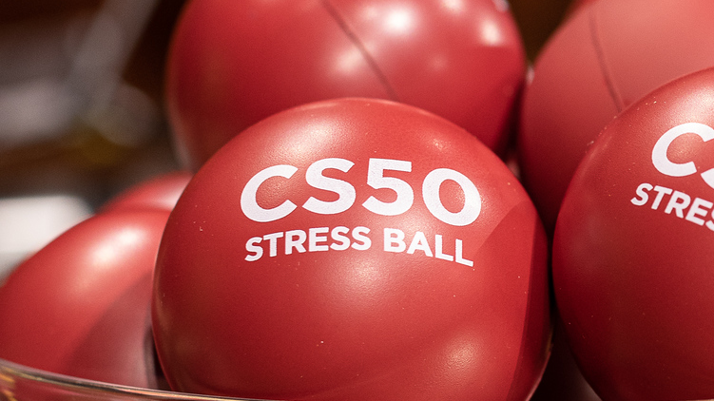

Slide 6
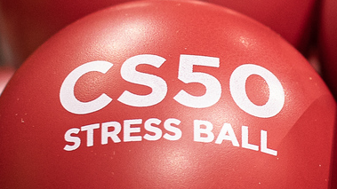

Slide 7


Slide 8


Slide 9


Slide 10
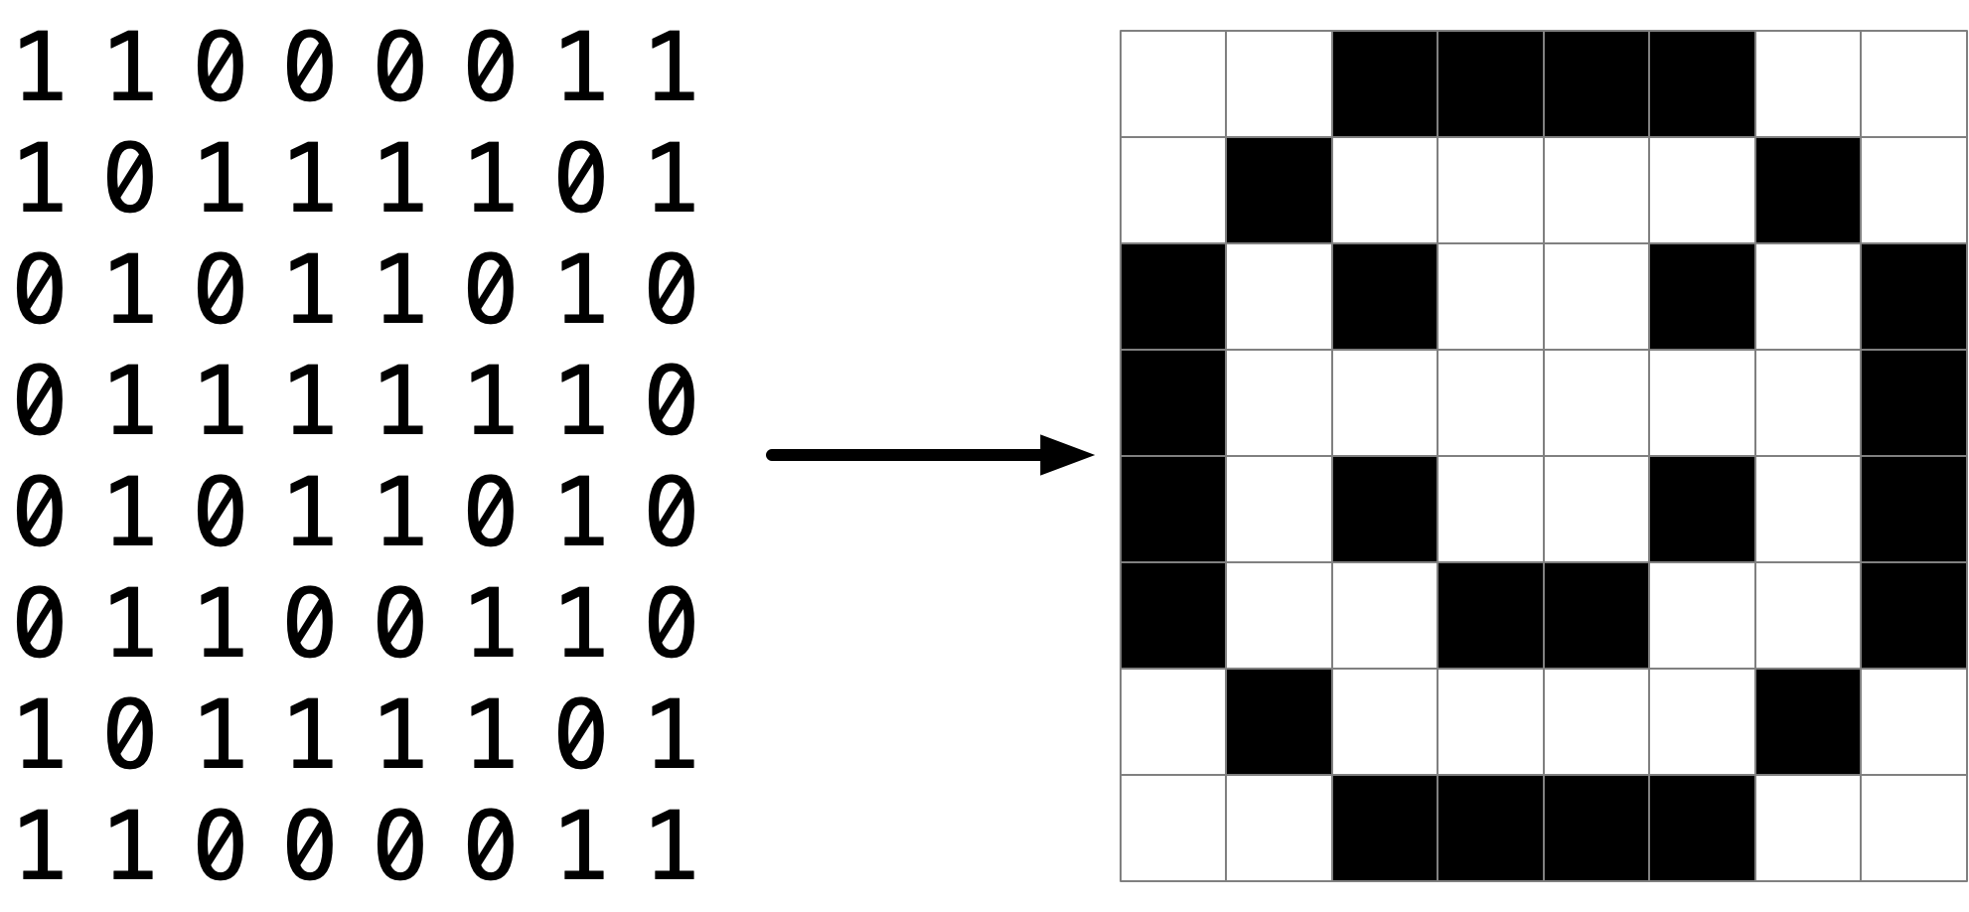

Slide 13
pixel art
Notes:
Reveal volunteer's artwork on stage, if any; invite others to make their own and send it to us

Slide 14
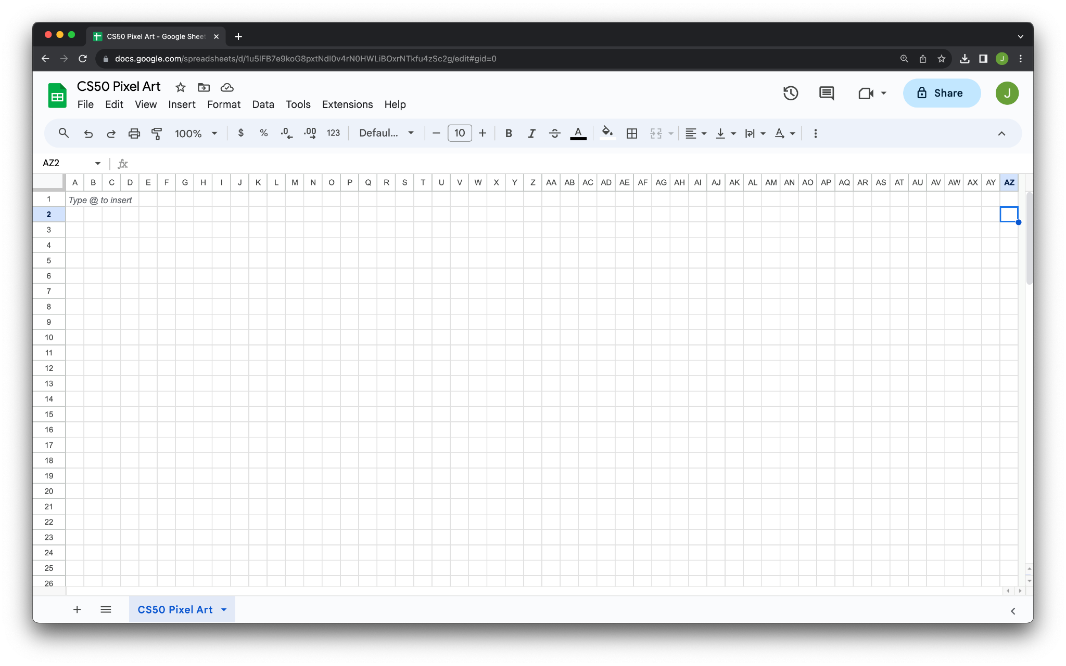

Slide 15


Slide 16
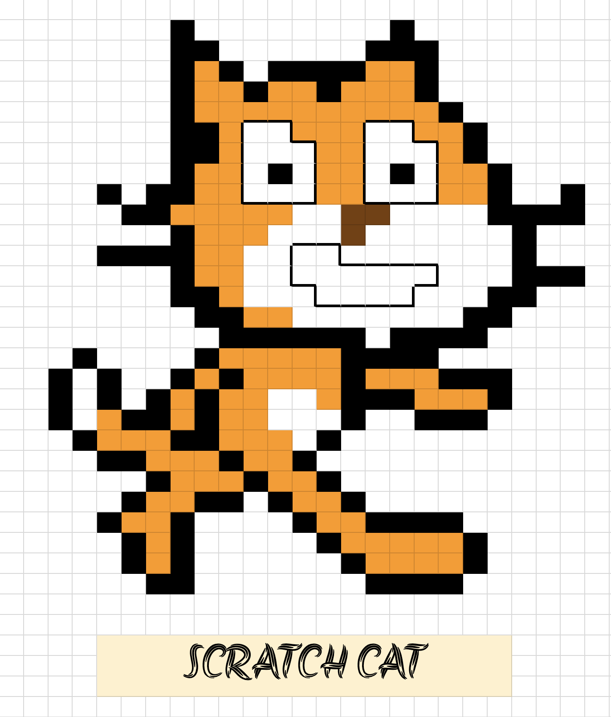

Slide 17
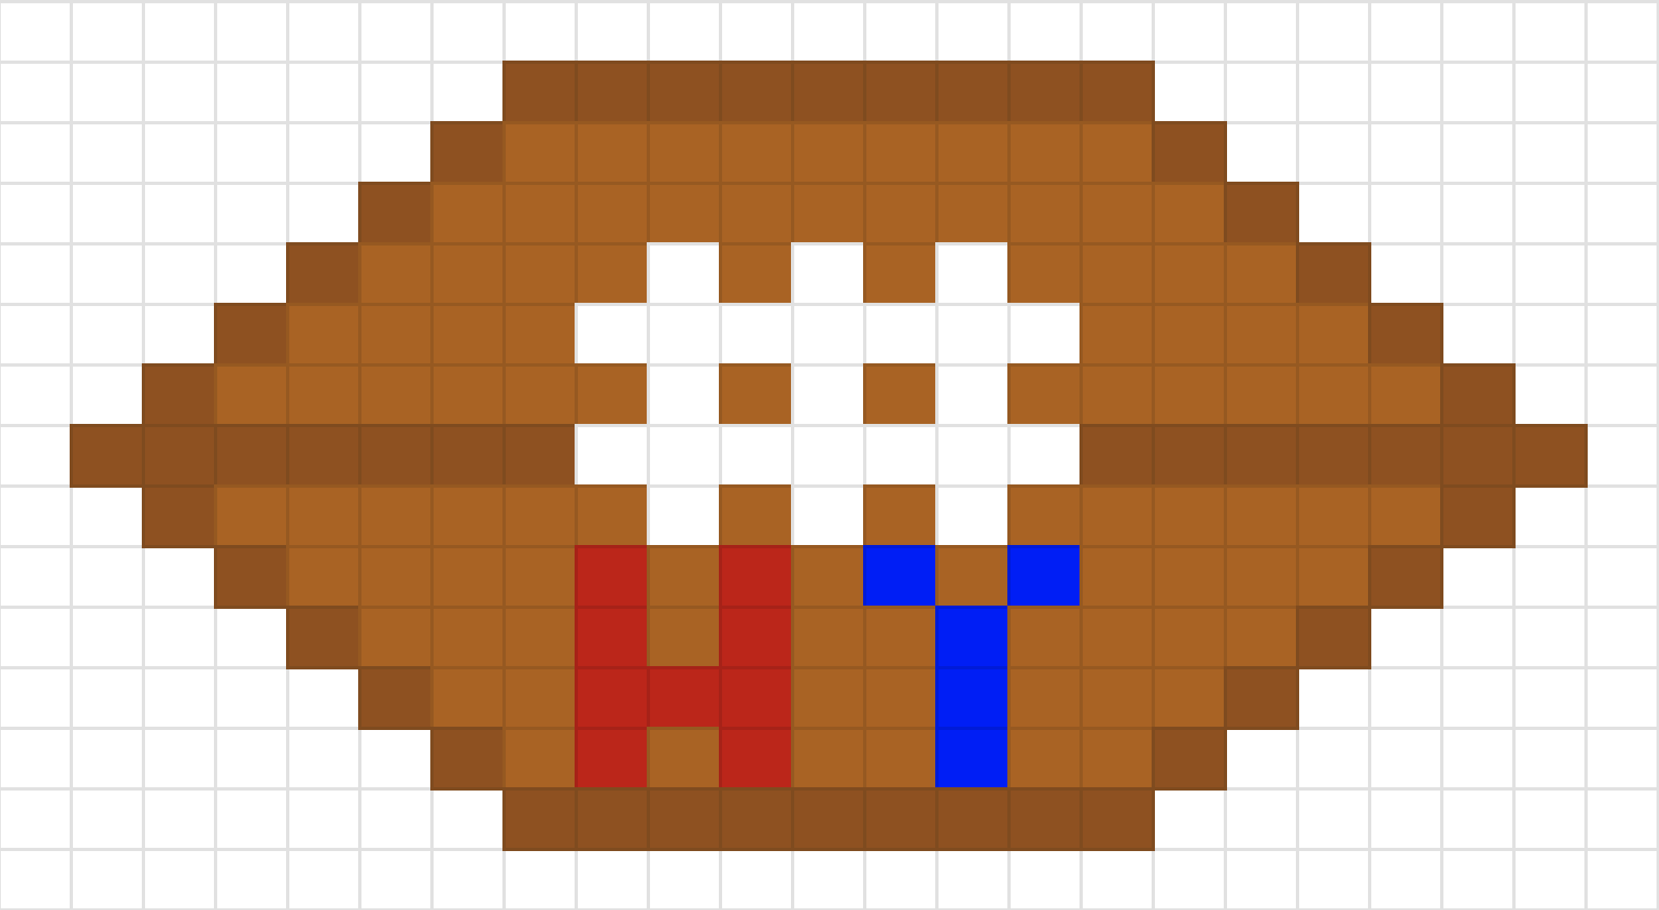

Slide 18


Slide 19
cs50.ly/art

Slide 20
RGB

Slide 21
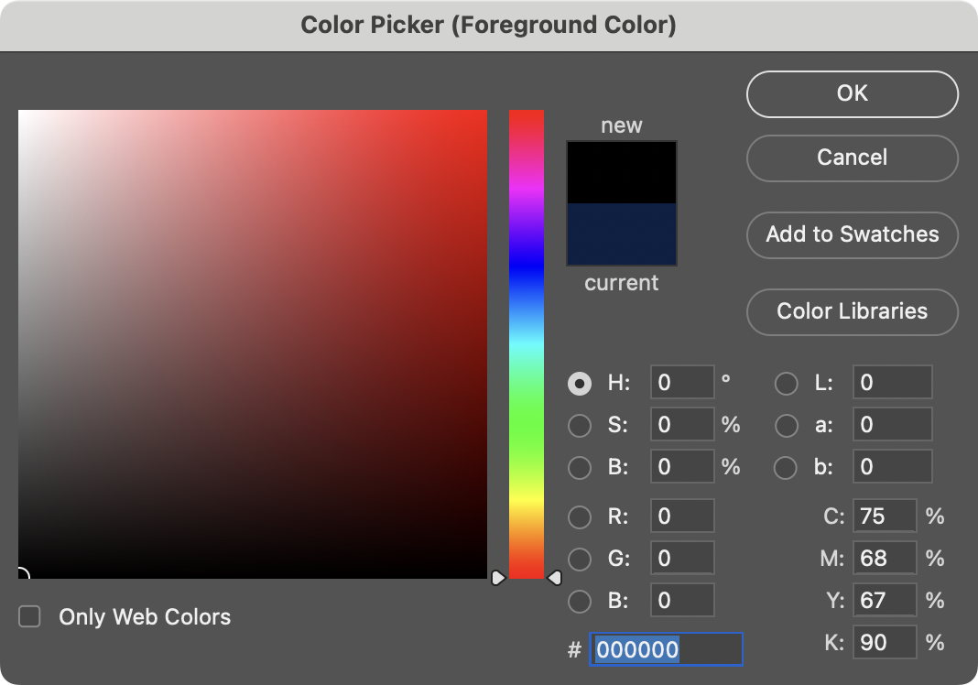

Slide 22
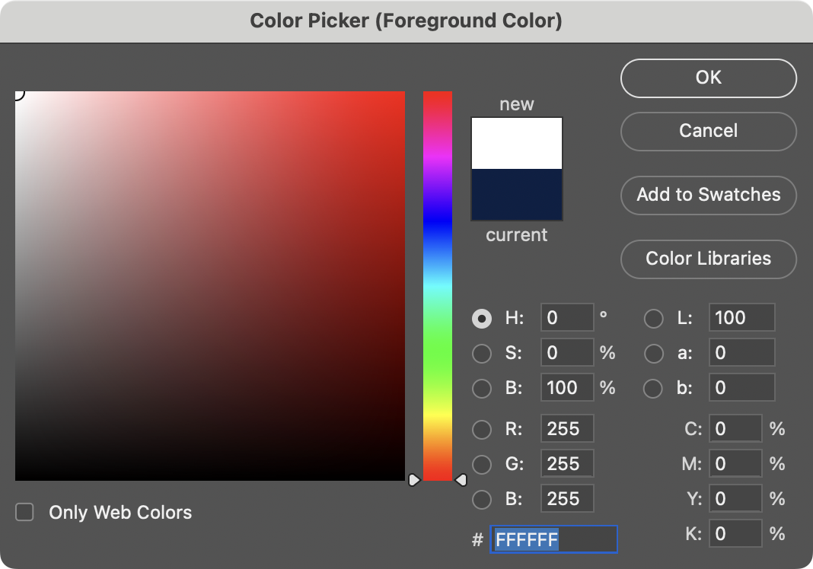
Notes:
White is 255 255 255. But what are these F's? hmmm

Slide 23
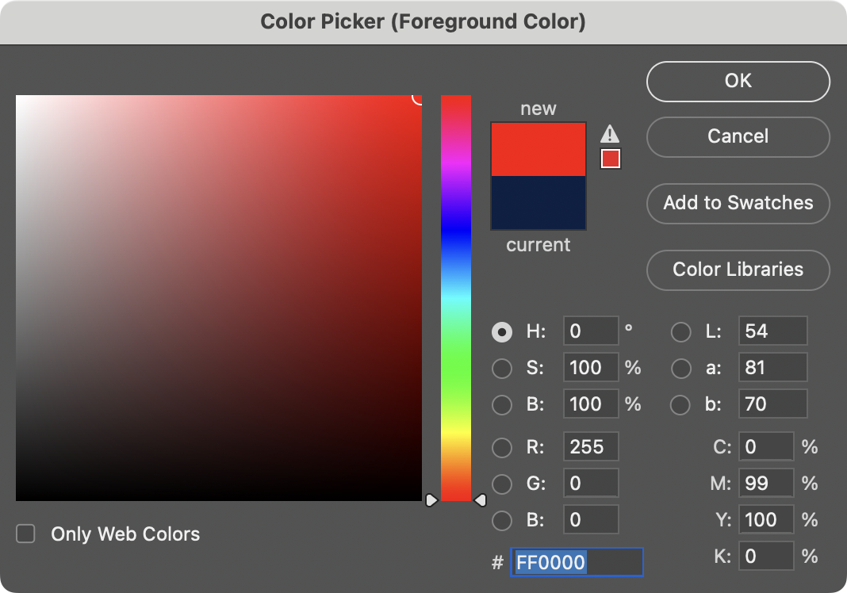

Slide 24
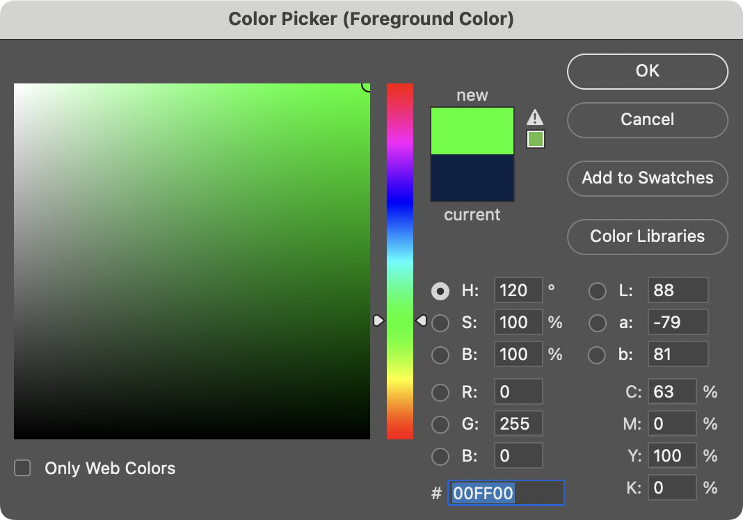

Slide 25
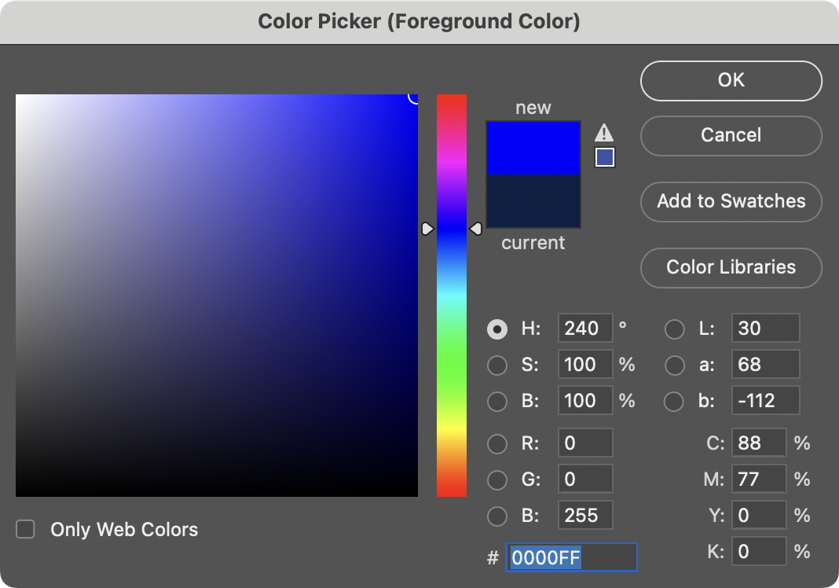

Slide 26
0 1 2 3 4 5 6 7 8 9 A B C D E F

Slide 27
0 1 2 3 4 5 6 7 8 9 A B C D E F

Slide 28
0 1 2 3 4 5 6 7 8 9 A B C D E F

Slide 29
0 1 2 3 4 5 6 7 8 9 a b c d e f

Slide 30
hexadecimal

Slide 31
base-16

Slide 32
16¹
16⁰
# #

Slide 33
16
1
# #

Slide 34
16
1
00

Slide 35
16
1
01

Slide 36
16
1
02

Slide 37
16
1
03

Slide 38
16
1
04

Slide 39
16
1
05

Slide 40
16
1
06

Slide 41
16
1
07

Slide 42
16
1
08

Slide 43
16
1
09

Slide 44
16
1
0A
Notes:
"ten"

Slide 45
16
1
0B
Notes:
"eleven"

Slide 46
16
1
0C

Slide 47
16
1
0D

Slide 48
16
1
0E

Slide 49
16
1
0F

Slide 50
16
1
10
Notes:
"one zero" not "ten"

Slide 51
16
1
11
Notes:
"one one", not "eleven"

Slide 52
16
1
12

Slide 53
16
1
13

Slide 54
16
1
14

Slide 55
16
1
…

Slide 56
16
1
FF

Slide 57
16
1
FF
16 × F
+
1 × F

Slide 58
16
1
FF
16 × 15
+
1 × 15

Slide 59
16
1
FF
240
+
15

Slide 60
16
1
FF
255
Notes:
So why is hex popular?

Slide 61
FF
Notes:
So why is hex popular?

Slide 62
F F
Notes:
So why is hex popular?

Slide 63
1111 1111
Notes:
So why is hex popular?

Slide 65
0 | 1 | 2 | 3 | 4 | 5 | 6 | 7
8 | 9 | 10 | 11 | 12 | 13 | 14 | 15
16 | 17 | 18 | 19 | 20 | 21 | 22 | 23
24 | 25 | 26 | 27 | 28 | 29 | 30 | 31

Slide 66
0 | 1 | 2 | 3 | 4 | 5 | 6 | 7
8 | 9 | A | B | C | D | E | F
10 | 11 | 12 | 13 | 14 | 15 | 16 | 17
18 | 19 | 1A | 1B | 1C | 1D | 1E | 1F

Slide 67
0 | 1 | 2 | 3 | 4 | 5 | 6 | 7
8 | 9 | A | B | C | D | E | F
10 | 11 | 12 | 13 | 14 | 15 | 16 | 17
18 | 19 | 1A | 1B | 1C | 1D | 1E | 1F

Slide 68
0x0 | 0x1 | 0x2 | 0x3 | 0x4 | 0x5 | 0x6 | 0x7
0x8 | 0x9 | 0xA | 0xB | 0xC | 0xD | 0xE | 0xF
0x10 | 0x11 | 0x12 | 0x13 | 0x14 | 0x15 | 0x16 | 0x17
0x18 | 0x19 | 0x1A | 0x1B | 0x1C | 0x1D | 0x1E | 0x1F

Slide 69
int n = 50;
Notes:
addresses0.c
Consider this code, how's it stored in memory?

Slide 71
 |  |  |  | 50 n

Slide 72
 |  |  |  | 50 0x123

Slide 73
&
*
Notes:
It turns out C has two operators that let us see and access addresses like that

Slide 74
%p
Notes:
addresses1.c

Slide 75
pointers
Notes:
A pointer is essentially an address, or more precisely a variable that can store an address.

Slide 76
int n = 50;
int *p = &n;
Notes:
addresses{2,3}.c

Slide 77
int n = 50;
int *p = &n;

Slide 78
int n = 50;
int* p = &n;

Slide 79
int n = 50;
int * p = &n;

Slide 80
int n = 50;
int *p = &n;

Slide 82
 |  |  |  | 50 n

Slide 83
 |  |  |  | 50 0x123

Slide 84
0x123 p
 |  |  |  | 50 0x123

Slide 85
0x123 p
 |  |  |  | 50 0x123

Slide 86
p
 |  |  |  | 50 0x123
Notes:
MAILBOX DEMO

Slide 87
string

Slide 88
string s = "HI!";

Slide 89
 |  |  | H | I | ! | \0

Slide 90
 |  |  | H s[0] | I s[1] | ! s[2] | \0 s[3]

Slide 91
 |  |  | H 0x123 | I 0x124 | ! 0x125 | \0 0x126

Slide 92
s
 |  |  | H 0x123 | I 0x124 | ! 0x125 | \0 0x126
Notes:
addresses{4,5}.c

Slide 93
0x123 s
 |  |  | H 0x123 | I 0x124 | ! 0x125 | \0 0x126
Notes:
addresses{4,5}.c

Slide 94
s
 |  |  | H 0x123 | I 0x124 | ! 0x125 | \0 0x126 | 0x127
Notes:
But who cares about the specific addresses, think of this just as a pointer literally, an arrow.

Slide 95
string s = "HI!";
Notes:
addresses6.c

Slide 96
string s = "HI!";

Slide 97
char *s = "HI!";
Notes:
addresses7.c
DROP TRAINING WHEELS.
It's just an address.

Slide 98
typedef struct
{
string name;
string number;
} person;
Notes:
So what is "string"? It's a type we defined for you. In fact, recall how we made our own type last week for a person.

Slide 99
typedef struct
{
string name;
string number;
} person;

Slide 100
typedef struct
{
string name;
string number;
} person;

Slide 101
typedef struct
{
string name;
string number;
} person;

Slide 102
typedef
Notes:
For instance, you could alias "integer" to be the same as "int". But no need to do that.

Slide 103
typedef int

Slide 104
typedef int integer;

Slide 105
typedef

Slide 106
typedef char *

Slide 107
typedef char * string;

Slide 108
typedef uint8_t BYTE;

Slide 109
typedef uint8_t BYTE;

Slide 110
typedef uint8_t BYTE;

Slide 111
typedef char *string;

Slide 112
typedef char *string;

Slide 113
typedef char *string;

Slide 114
cs50.h

Slide 115
pointer arithmetic
Notes:
addresses{8,9,10}.c
Were these ints instead of chars, you would still do +1, and the compiler would know that it's really +4.

Slide 116
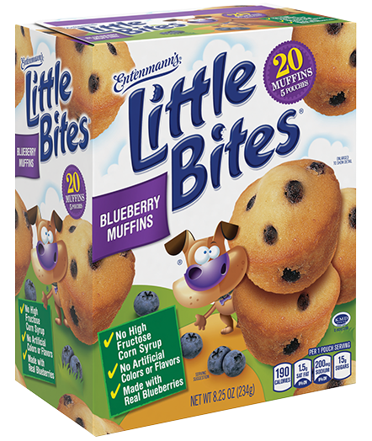
Notes:
https://www.littlebites.com/variety/little-bites-blueberry-muffins

Slide 117
typedef char * string;

Slide 118
typedef char *string;

Slide 119
Notes:
compare0.c

Slide 120
50 i |  |  |  | 50 j

Slide 121
strcmp
Notes:
compare{1,2}.c
Have to type "HI!"

Slide 123
s

Slide 124
s
 |  | H | I | ! | \0

Slide 125
s
 |  | H 0x123 | I 0x124 | ! 0x125 | \0 0x126

Slide 126
0x123 s
 |  | H 0x123 | I 0x124 | ! 0x125 | \0 0x126

Slide 127
0x123 s |  |  |  |  |  |  |  | t
 |  | H 0x123 | I 0x124 | ! 0x125 | \0 0x126

Slide 128
0x123 s |  |  |  |  |  |  |  | t
 |  | H 0x123 | I 0x124 | ! 0x125 | \0 0x126 |  |  |  |  | H | I | ! | \0

Slide 129
0x123 s |  |  |  |  |  |  |  | t
 |  | H 0x123 | I 0x124 | ! 0x125 | \0 0x126 |  |  |  |  | H 0x456 | I 0x457 | ! 0x458 | \0 0x459

Slide 130
0x123 s |  |  |  |  |  |  |  | 0x456 t
 |  | H 0x123 | I 0x124 | ! 0x125 | \0 0x126 |  |  |  |  | H 0x456 | I 0x457 | ! 0x458 | \0 0x459

Slide 131
s |  |  |  |  |  |  |  | t
 |  | H 0x123 | I 0x124 | ! 0x125 | \0 0x126 |  |  |  |  | H 0x456 | I 0x457 | ! 0x458 | \0 0x459
Notes:
compare{3,4}.c

Slide 132
Notes:
copy{0,1}.c
Have to use "hi!" in lowercase

Slide 133
s

Slide 134
s
 |  | h | i | ! | \0

Slide 135
s
 |  | h 0x123 | i 0x124 | ! 0x125 | \0 0x126

Slide 136
0x123 s
 |  | h 0x123 | i 0x124 | ! 0x125 | \0 0x126

Slide 137
0x123 s |  |  |  |  |  |  |  | t
 |  | h 0x123 | i 0x124 | ! 0x125 | \0 0x126

Slide 138
0x123 s |  |  |  |  |  |  |  | 0x123 t
 |  | h 0x123 | i 0x124 | ! 0x125 | \0 0x126

Slide 139
s |  |  |  |  |  |  |  | t
 |  | h 0x123 | i 0x124 | ! 0x125 | \0 0x126

Slide 140
s |  |  |  |  |  |  |  | t
 |  | H 0x123 | i 0x124 | ! 0x125 | \0 0x126

Slide 141
malloc
free
…
Notes:
copy{2,3,4}.c

Slide 142
s
 |  | h 0x123 | i 0x124 | ! 0x125 | \0 0x126

Slide 143
s |  |  |  |  |  |  |  | t
 |  | h 0x123 | i 0x124 | ! 0x125 | \0 0x126

Slide 144
s |  |  |  |  |  |  |  | t
 |  | h 0x123 | i 0x124 | ! 0x125 | \0 0x126 |  |  |  |  | 0x456 | 0x457 | 0x458 | 0x459

Slide 145
s |  |  |  |  |  |  |  | t
 |  | h 0x123 | i 0x124 | ! 0x125 | \0 0x126 |  |  |  |  | 0x456 | 0x457 | 0x458 | 0x459

Slide 146
s |  |  |  |  |  |  |  | t
 |  | h 0x123 | i 0x124 | ! 0x125 | \0 0x126 |  |  |  |  | h 0x456 | 0x457 | 0x458 | 0x459

Slide 147
s |  |  |  |  |  |  |  | t
 |  | h 0x123 | i 0x124 | ! 0x125 | \0 0x126 |  |  |  |  | h 0x456 | i 0x457 | 0x458 | 0x459

Slide 148
s |  |  |  |  |  |  |  | t
 |  | h 0x123 | i 0x124 | ! 0x125 | \0 0x126 |  |  |  |  | h 0x456 | i 0x457 | ! 0x458 | 0x459

Slide 149
s |  |  |  |  |  |  |  | t
 |  | h 0x123 | i 0x124 | ! 0x125 | \0 0x126 |  |  |  |  | h 0x456 | i 0x457 | ! 0x458 | \0 0x459

Slide 150
s |  |  |  |  |  |  |  | t
 |  | h 0x123 | i 0x124 | ! 0x125 | \0 0x126 |  |  |  |  | H 0x456 | i 0x457 | ! 0x458 | \0 0x459

Slide 151
NULL
Notes:
copy5.c

Slide 152
valgrind
Notes:
memory.c, create in advance
[Note: not necessary to free strings returned by get_string, CS50's library does for you.]

Slide 153
garbage values
Notes:
garbage.c

Slide 154
int main(void)
{
int *x;
int *y;
x = malloc(sizeof(int));
*x = 42;
*y = 13;
y = x;
*y = 13;
}

Slide 155
int main(void)
{
int *x;
int *y;
x = malloc(sizeof(int));
*x = 42;
*y = 13;
y = x;
*y = 13;
}

Slide 156
int main(void)
{
int *x;
int *y;
x = malloc(sizeof(int));
*x = 42;
*y = 13;
y = x;
*y = 13;
}

Slide 157
int main(void)
{
int *x;
int *y;
x = malloc(sizeof(int));
*x = 42;
*y = 13;
y = x;
*y = 13;
}

Slide 158
int main(void)
{
int *x;
int *y;
x = malloc(sizeof(int));
*x = 42;
*y = 13;
y = x;
*y = 13;
}

Slide 159
int main(void)
{
int *x;
int *y;
x = malloc(sizeof(int));
*x = 42;
*y = 13;
y = x;
*y = 13;
}
Notes:
So maybe we shouldn't do that

Slide 160
int main(void)
{
int *x;
int *y;
x = malloc(sizeof(int));
*x = 42;
*y = 13;
y = x;
*y = 13;
}
Notes:
But what if we instead…

Slide 161
int main(void)
{
int *x;
int *y;
x = malloc(sizeof(int));
*x = 42;
*y = 13;
y = x;
*y = 13;
}

Slide 162
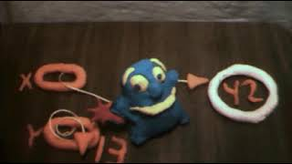
Notes:
https://www.youtube.com/watch?v=3uLKjb973HU

Slide 163
void swap(int a, int b)
{
}
Notes:
A lot of last week's demos involved swapping…
DRINKING GLASS DEMO

Slide 164
void swap(int a, int b)
{
int tmp = a;
a = b;
b = tmp;
}
Notes:
swap0.c
Have this one ready to go in a swap.c file

Slide 165
void swap(int a, int b)
{
int tmp = a;
a = b;
b = tmp;
}

Slide 166
scope

Slide 167
passing by value

Slide 168
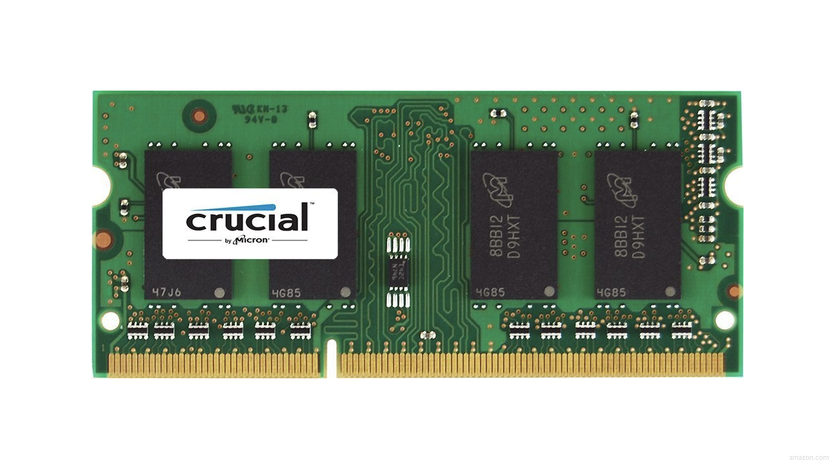

Slide 172
↑
stack

Slide 173
machine code
↑
stack

Slide 174
machine code
globals
heap
↓
↑
stack

Slide 175
machine code
globals
heap
↓
↑
stack

Slide 176
machine code
globals
heap
↓
↑
stack

Slide 177
machine code
globals
heap
↓
↑
stack

Slide 178
machine code
globals
heap
↓
↑
stack

Slide 179
↑
stack
Notes:
show swap0.c again

Slide 180
void swap(int a, int b)
{
int tmp = a;
a = b;
b = tmp;
}

Slide 181
main

Slide 182
swap
main

Slide 183
main

Slide 184
x
y

Slide 185
1
x
2
y

Slide 186
swap
1
x
2
y

Slide 187
a
b
tmp
1
x
2
y

Slide 188
1
a
2
b
tmp
1
x
2
y

Slide 189
int tmp = a;
a = b;
b = tmp;
1
a
2
b
tmp
1
x
2
y

Slide 190
int tmp = a;
a = b;
b = tmp;
1
a
2
b
1
tmp
1
x
2
y

Slide 191
int tmp = a;
a = b;
b = tmp;
2
a
2
b
1
tmp
1
x
2
y

Slide 192
int tmp = a;
a = b;
b = tmp;
2
a
1
b
1
tmp
1
x
2
y

Slide 193
2
a
1
b
1
tmp
1
x
2
y

Slide 194
1
x
2
y

Slide 195
passing by reference
Notes:
so how fix?

Slide 196
void swap(int a, int b)
{
int tmp = a;
a = b;
b = tmp;
}

Slide 197
void swap(int *a, int *b)
{
int tmp = *a;
*a = *b;
*b = tmp;
}

Slide 198
void swap(int *a, int *b)
{
int tmp = *a;
*a = *b;
*b = tmp;
}
Notes:
swap1.c

Slide 199
1
x
2
y

Slide 200
a
b
tmp
1
x
2
y

Slide 201
int tmp = *a;
*a = *b;
*b = tmp;
a
b
tmp
1
x
2
y

Slide 202
int tmp = *a;
*a = *b;
*b = tmp;
a
b
1
tmp
1
x
2
y

Slide 203
int tmp = *a;
*a = *b;
*b = tmp;
a
b
1
tmp
2
x
2
y

Slide 204
int tmp = *a;
*a = *b;
*b = tmp;
a
b
1
tmp
2
x
1
y

Slide 205
a
b
1
tmp
2
x
1
y

Slide 206
2
x
1
y

Slide 207
void swap(int a, int b)
{
int tmp = a;
a = b;
b = tmp;
}

Slide 208
void swap(int *a, int *b)
{
int tmp = *a;
*a = *b;
*b = tmp;
}

Slide 209
machine code
globals
heap
↓
↑
stack

Slide 210
heap
↓
↑
stack
Notes:
What's bad about this picture?

Slide 211
heap overflow
stack overflow

Slide 212
buffer overflow

Slide 213


Slide 214
"Sensors that received the new version of Channel File 291 carrying the problematic content were exposed to a latent out-of-bounds read issue in the Content Interpreter. At the next IPC notification from the operating system, the new IPC Template Instances were evaluated, specifying a comparison against the 21st input value. The Content Interpreter expected only 20 values. Therefore, the attempt to access the 21st value produced an out-of-bounds memory read beyond the end of the input data array and resulted in a system crash."
Notes:
https://www.crowdstrike.com/wp-content/uploads/2024/08/Channel-File-291-Incident-Root-Cause-Analysis-08.06.2024.pdf

Slide 215
"Sensors that received the new version of Channel File 291 carrying the problematic content were exposed to a latent out-of-bounds read issue in the Content Interpreter. At the next IPC notification from the operating system, the new IPC Template Instances were evaluated, specifying a comparison against the 21st input value. The Content Interpreter expected only 20 values. Therefore, the attempt to access the 21st value produced an out-of-bounds memory read beyond the end of the input data array and resulted in a system crash."

Slide 216
get_char
get_double
get_float
get_int
get_long
get_string
...
Notes:
So how about these other training wheels?

Slide 217
get_int
Notes:
get0.c

Slide 218
scanf
…
Notes:
get1.c

Slide 220


Slide 221
 | 50 n

Slide 223
Notes:
get2.c

Slide 224
s

Slide 225
s

Slide 226
s

Slide 228
Notes:
get3.c

Slide 229
s
Notes:
get3.c
get_int allocates just enough memory + 1

Slide 230
file I/O

Slide 231
fopen
fclose
fprintf
fscanf
fread
fwrite
fseek
…
Notes:
phonebook{0,1}.c

Slide 232

Notes:
cp.c
https://stock.adobe.com/search/video?k=progress+bar

Slide 233
BMP

Slide 234
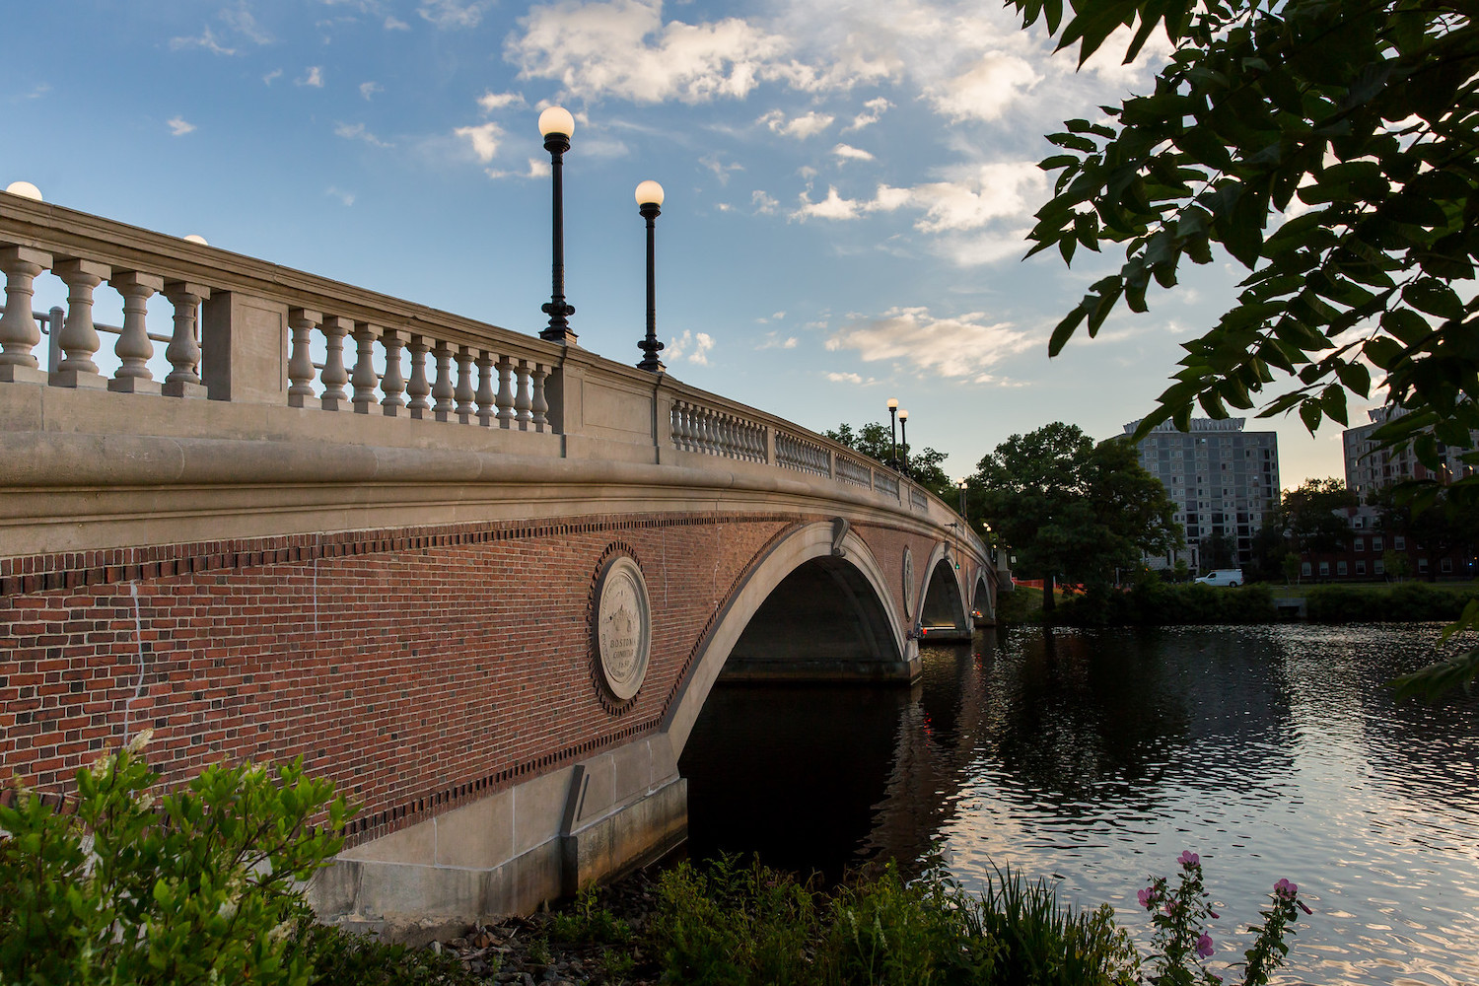

Slide 235
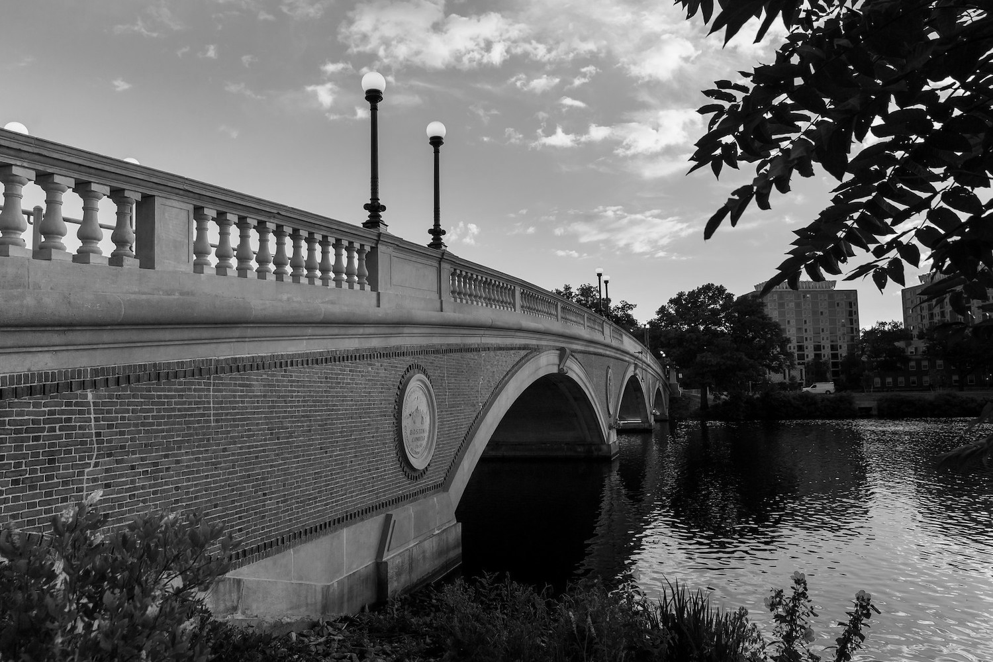
Notes:
grayscale

Slide 236
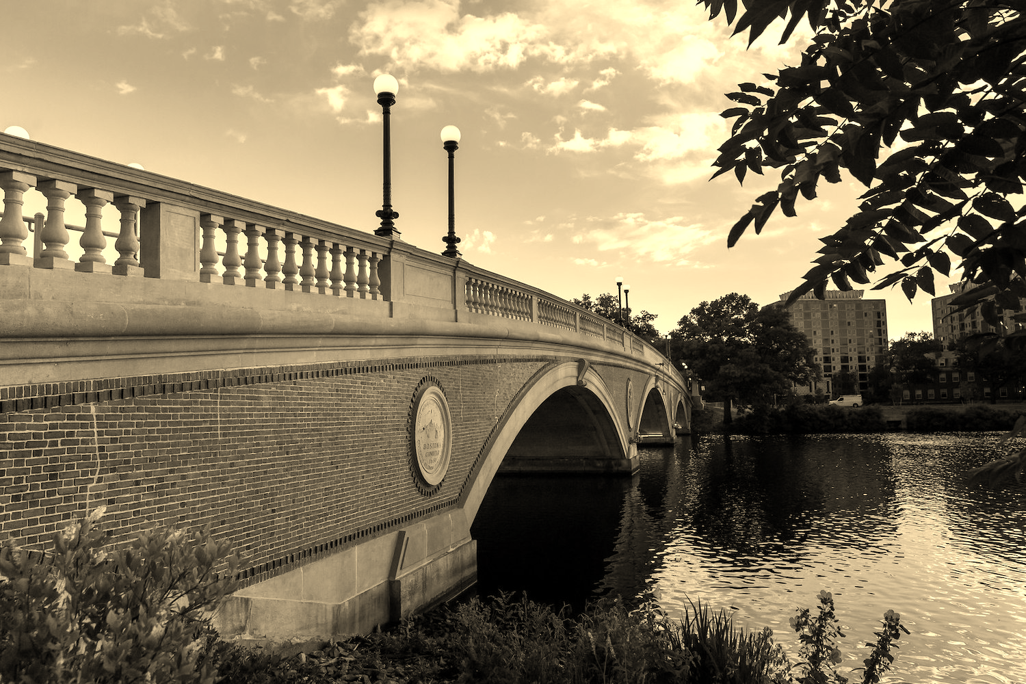
Notes:
sepia

Slide 237
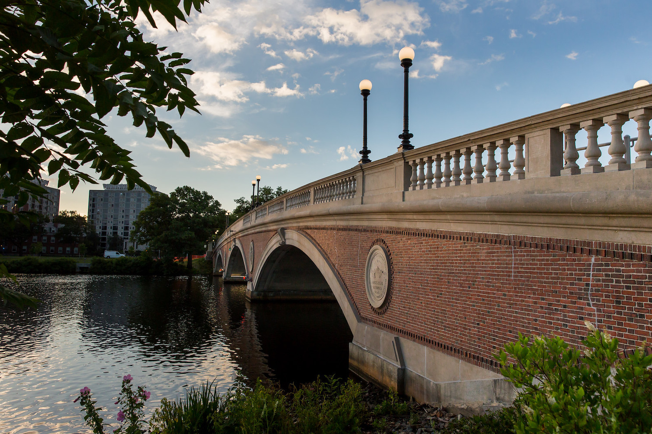
Notes:
reflect

Slide 238

Notes:
blur

Slide 239
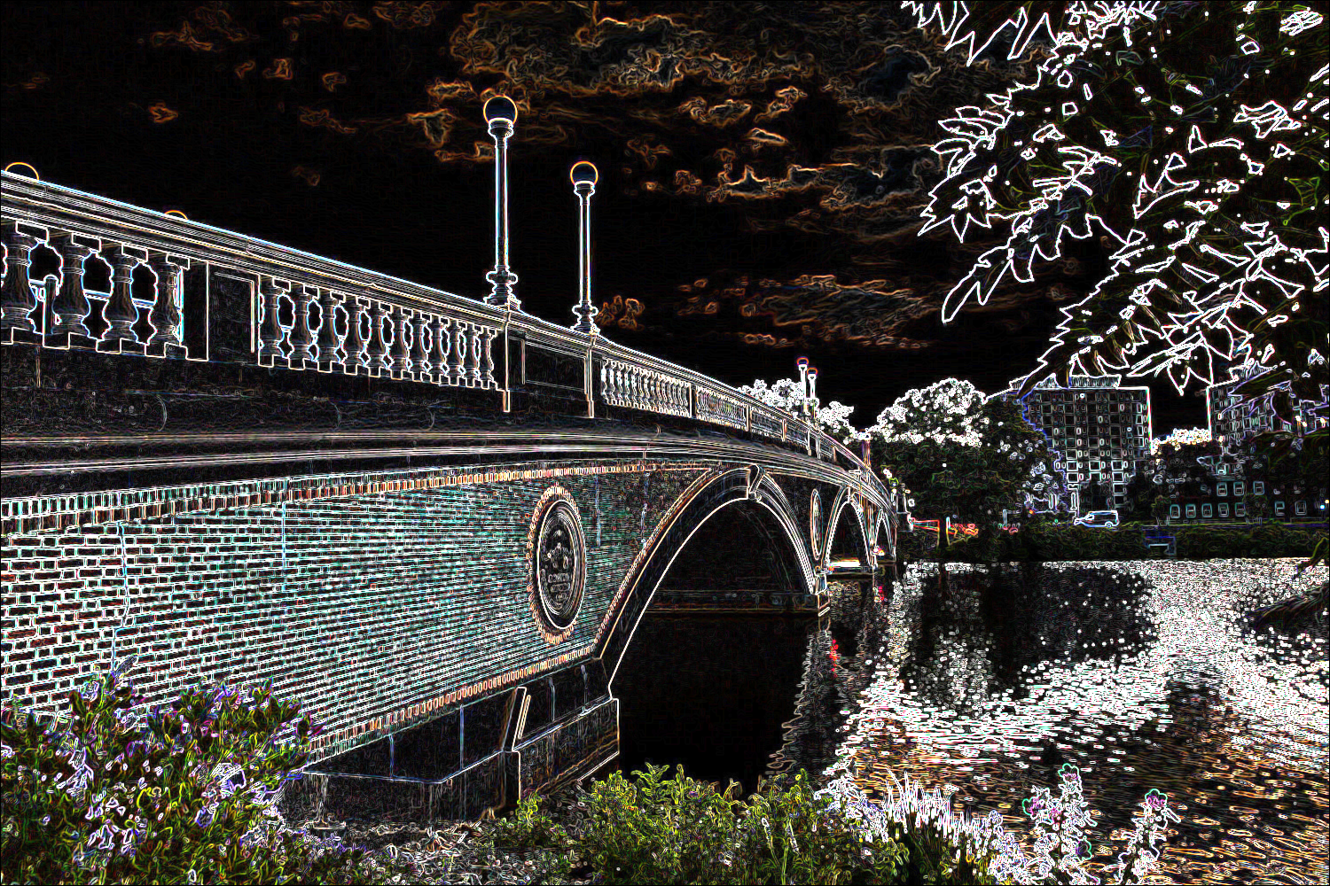
Notes:
edge detection

Slide 240
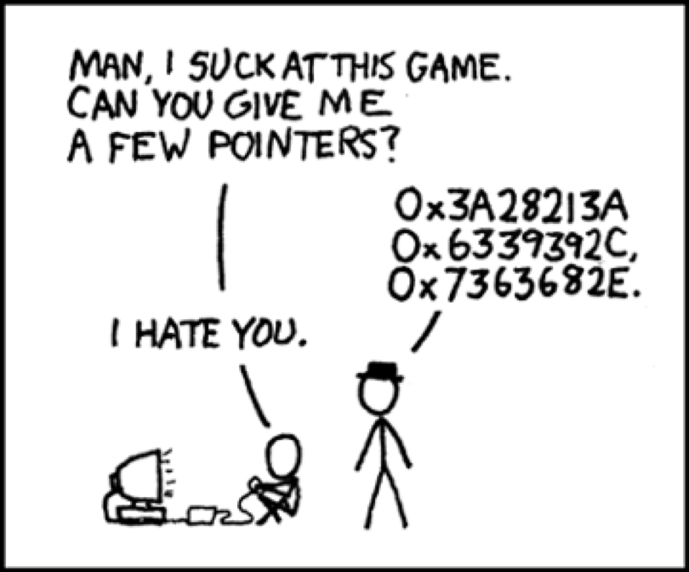
Notes:
https://xkcd.com/138/

